Slide 1
ITNW 1335 Cloud Computing
Chapter 3 - Understanding Cloud Computing

Slide 2
3.1. Origins and Influences
Computer Scientist John McCarthy publicly proposed in 1961:
“If computers of the kind I have advocated become the computers of the future, then computing may someday be organized as a public utility just as the telephone system is a public utility. ... The computer utility could become the basis of a new and important industry.”
In 1969, Leonard Kleinrock, a chief scientist of the Advanced Research Projects Agency Network or ARPANET project that seeded the Internet, stated:
“As of now, computer networks are still in their infancy, but as they grow up and become sophisticated, we will probably see the spread of ‘computer utilities’ ...”.
We have been on our way to cloud commuting since the 1990
Search engines, email services, open publishing platform, and other social media
In 2002, Amazon.com launched the Amazon Web Services (AWS) platform, a suite of enterprise-oriented services that provide remotely provisioned storage, computing resources, and business functionality

Slide 3
3.1. Origins and Influences
In the 1990s, Cloud referred to an abstraction layer derived in the delivery methods of data across heterogeneous public and semi-public networks that were primarily packet-switched
The networking method at this point supported
the transmission of data from one end-point (local network)
to the “Cloud” (wide area network)
then further decomposed to another intended end-point.
In 2006 the term “cloud computing” emerged in the commercial arena.
Amazon launched its Elastic Compute Cloud (EC2) services that enabled organizations to “lease” computing capacity and processing power to run their enterprise applications
Google Apps also began providing browser-based enterprise applications
In 2009 the Google App Engine became another historic milestone

Slide 4
Definitions
A Gartner report listing cloud computing at the top of its strategic technology areas further reaffirmed its prominence as an industry trend by announcing its formal definition as:
“...a style of computing in which scalable and elastic (used massively scalable in 2008 def.) IT-enabled capabilities are delivered as a service to external customers using Internet technologies.”
Forrester Research provided its own definition of cloud computing as:
“...a standardized IT capability (services, software, or infrastructure) delivered via Internet technologies in a pay-per-use, self-service way.”
The NIST’s definition, after industry input, received industry-wide acceptance:
“Cloud computing is a model for enabling ubiquitous, convenient, on-demand network access to a shared pool of configurable computing resources (e.g., networks, servers, storage, applications, and services) that can be rapidly provisioned and released with minimal management effort or service provider interaction. This cloud model is composed of five essential characteristics, three service models, and four deployment models.”
The book:
“Cloud computing is a specialized form of distributed computing that introduces utilization models for remotely provisioning scalable and measured resources.”

Slide 5
3.1. Origins and Influences
Several factors influences the proliferation of cloud computing including
Business Drivers
Capacity Planning
Cost Reduction
Organization Agility
Technology Innovations
Clustering
Grid Computing
Virtualization
Technology Innovations vs. Enabling Technologies

Slide 6
3.1. Origins and Influences
Business Drivers:
fostered modern cloud-based technology
These influences shaped clouds and the overall cloud computing market from both ends
Have motivated organizations to adopt cloud computing in support of their business automation requirements
Have correspondingly motivated other organizations to become providers of cloud environments and cloud technology vendors in order to create and meet the demand to fulfill consumer needs
Capacity Planning
the process of determining and fulfilling future demands of an organization’s IT resources, products, and services
Capacity represents the maximum amount of work that an IT resource is capable of delivering in a given period of time
A discrepancy between the capacity of an IT resource and its demand can result in a system becoming either inefficient (over-provisioning) or unable to fulfill user needs (under-provisioning)
Capacity planning is focused on minimizing this discrepancy to achieve predictable efficiency and performance

Slide 7
3.1. Origins and Influences
Capacity Planning Strategies
Lead Strategy – adding capacity to an IT resource in anticipation of demand
Lag Strategy – adding capacity when the IT resource reaches its full capacity
Match Strategy – adding IT resource capacity in small increments, as demand increases
Planning for capacity can be challenging because it requires estimating usage load fluctuations
There is a constant need to balance peak usage requirements without unnecessary over-expenditure on infrastructure
An example is outfitting IT infrastructure to accommodate maximum usage loads which can impose unreasonable financial investments.
In such cases, moderating investments can result in under-provisioning, leading to transaction losses and other usage limitations from lowered usage thresholds

Slide 8
3.1. Origins and Influences
Cost Reduction
A direct alignment between IT costs and business performance can be difficult to maintain
The growth of IT environments relates to the assessment of their maximum usage requirements
New and expanded business automations can be an ever-increasing investment
Much of this investment is funneled into infrastructure expansion because the usage potential of a given automation solution will always be limited by the processing power of its underlying infrastructure
Two costs need to be accounted for:
the cost of acquiring new infrastructure
technical personnel required to keep the environment operational
upgrades and patches that introduce additional testing and deployment cycles
utility bills and capital expense investments for power and cooling
security and access control measures that need to be maintained and enforced to protect infrastructure resources
administrative and accounts staff that may be required to keep track of licenses and support arrangements
the cost of its ongoing ownership
burdensome responsibilities that impose compound impacts on corporate budgets
An IT department can consequently become a significant, and at times overwhelming, drain on the business, potentially inhibiting its responsiveness, profitability, and overall evolution

Slide 9
3.1. Origins and Influences
Organizational Agility
the measure of an organization’s responsiveness to change.
Businesses need the ability to adapt and evolve to successfully face change caused by both internal and external factors
IT enterprise needs to respond to changes by scaling beyond a previously planned model
This must be done even with budget constraints
Changing business needs and priorities may require IT resources to be more available and reliable than before
Even if sufficient infrastructure is in place for an organization to support anticipated usage volumes, some usage may generate runtime exceptions that bring down hosting servers
The lack of reliability threatens business continuity
Upfront cost may cause a business to settle for a less-than-ideal solution so real-world needs aren’t met
Enterprise may even scrap an automated solution altogether due to budget

Slide 10
3.1. Origins and Influences
Technology Innovations are new or improved products, services, or processes whose technological characteristic are significantly different from before (Established technologies)
Clustering
A cluster is a group of independent IT resources that are interconnected and work as a single system
System failure rates are reduced while availability and reliability are increased, since redundancy and failover features are inherent to the cluster
Must have similar hardware and OS
Grid Computing
a platform in which computing resources are organized into one or more logical pools.
These pools are collectively coordinated to provide a high performance distributed grid
Differs from clustering in that grid systems are much more loosely coupled and distributed
Systems can involve computing resources that are heterogeneous and geographically dispersed, which is generally not possible with cluster computing-based systems

Slide 11
3.1. Origins and Influences - Technology Innovations
Virtualization
Virtualization represents a technology platform used for the creation of virtual instances of IT resources
A layer of virtualization software allows physical IT resources to provide multiple virtual images of themselves so that their underlying processing capabilities can be shared by multiple users
Prior to the advent of virtualization technologies, software was limited to residing on and being coupled with static hardware environments
The virtualization process severs this software-hardware dependency, as hardware requirements can be simulated by emulation software running in virtualized environments
Established virtualization technologies can be traced to several cloud characteristics and cloud computing mechanisms
As cloud computing evolved, a generation of modern virtualization technologies emerged to overcome the performance, reliability, and scalability limitations of traditional virtualization platforms

Slide 12
3.1. Origins and Influences - Technology Innovations
Technology Innovations vs. Enabling Technologies
Broadband Networks and Internet Architecture
Data Center Technology
(Modern) Virtualization Technology
Web Technology
Multitenant Technology
Service Technology
Each of these cloud-enabling technologies existed in some form prior to the formal advent of cloud computing
Some were refined further, and on occasion even redefined, as a result of the subsequent evolution of cloud computing

Slide 13
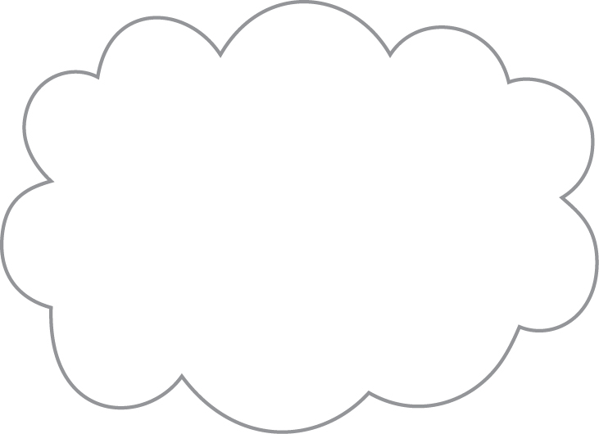
3.2. Basic Concepts and Terminology - cloud
A cloud refers to a distinct IT environment that is designed for the purpose of remotely provisioning scalable and measured IT resources
The term originated as a metaphor for the Internet which is, in essence, a network of networks providing remote access to a set of decentralized IT resources
Prior to cloud computing becoming its own formalized IT industry segment, the symbol of a cloud was commonly used to represent the Internet
Internet primary protocol is HTTP
A cloud has finite boundaries
Clouds are accessible via the Internet
Clouds aren’t necessarily Web based
Figure 3.1 The symbol used to denote the boundary of a cloud environment.
Notes:
No figures in Chapters 1 and 2.

Slide 14
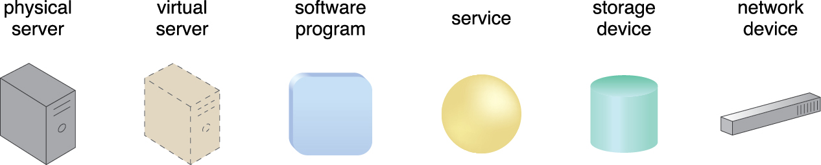
3.2. Basic Concepts and Terminology – IT Resources
An IT resource is a physical or virtual IT-related artifact that can be either software-based, such as a virtual server or a custom software program, or hardware-based, such as a physical server or a network device
Figure 3.2 Examples of common IT resources and their corresponding symbols.
Notes:
Figure:

Slide 15
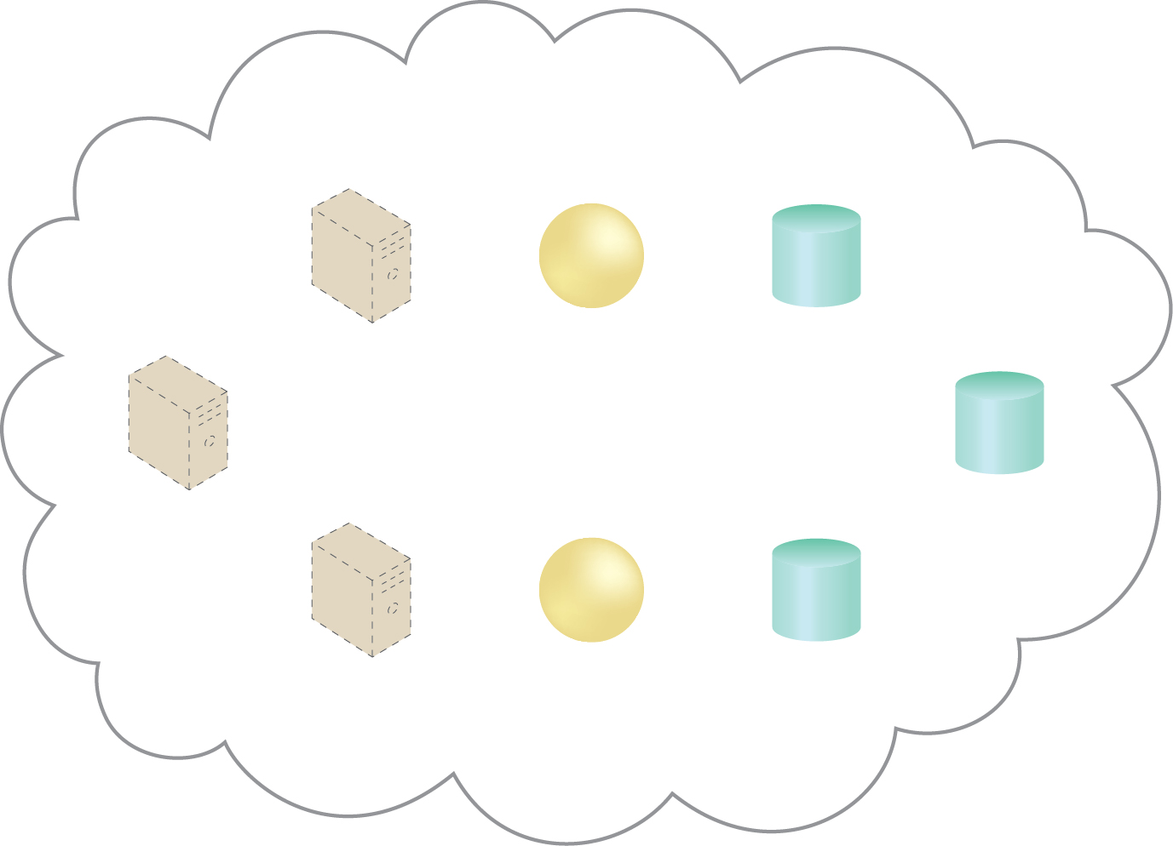
3.2. Basic Concepts and Terminology – IT Resources
The cloud symbol can be used to define a boundary for a cloud environment
Displayed IT resources are considered cloud-based IT resources
It is important to note the following points when studying and working with these diagrams:
The IT resources shown within the boundary of a given cloud symbol usually do not represent all of the available IT resources hosted by that cloud. Subsets of IT resources are generally highlighted to demonstrate a particular topic.
Focusing on the relevant aspects of a topic requires many of these diagrams to intentionally provide abstracted views of the underlying technology architectures. This means that only a portion of the actual technical details are shown
Furthermore, some diagrams will display IT resources outside of the cloud symbol.
This convention is used to indicate IT resources that are not cloud-based
Figure 3.3 A cloud is hosting eight IT resources: three virtual servers, two cloud services, and three storage devices.
Notes:
Figure:

Slide 16
3.2. Basic Concepts and Terminology – On Premise
An IT resource that is hosted in a conventional enterprise environment within the organizational boundary location on the premise of the IT enterprise is said to be on-premise or sometimes said “on-prem”
On-premise resources cannot be cloud-based
Note:
An on-premise IT resource can access and interact with a cloud-based IT resource
An on-premise IT resource can be moved to a cloud, thereby changing it to a cloud-based IT resource
Redundant deployments of an IT resource can exist in both on-premise and cloud-based environments.

Slide 17
3.2. Basic Concepts and Terminology – Cloud Consumers/providers
The party that provides cloud-based IT resources is the cloud provider
The party that uses cloud-based IT resources is the cloud consumer.
Scaling represent the ability of the resource to handle increased or decreased usage demands
Horizontal Scaling – scaling out and scaling in
Vertical Scaling – scaling up and scaling down
Notes:
Figure:

Slide 18
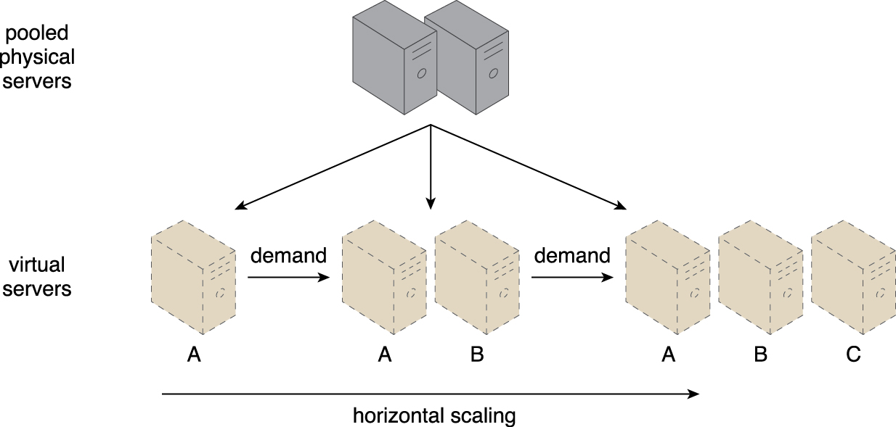
3.2. Basic Concepts and Terminology – Horizontal Scaling
The allocating or releasing of IT resources that are of the same type is referred to as horizontal scaling
The horizontal allocation of resources is referred to as scaling out and the horizontal releasing of resources is referred to as scaling in
Horizontal scaling is a common form of scaling within cloud environments
Figure 3.4 An IT resource (Virtual Server A) is scaled out by adding more of the same IT
resources (Virtual Servers B and C).
Notes:
Figure:

Slide 19
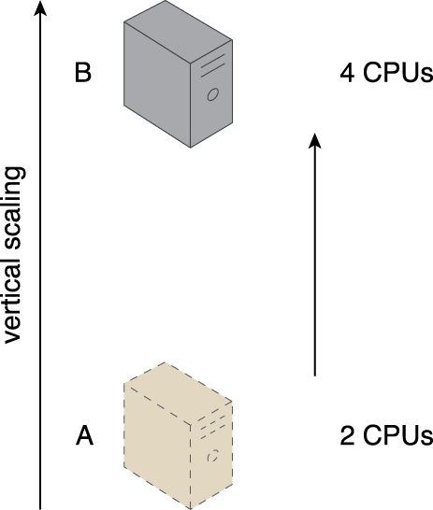
3.2. Basic Concepts and Terminology – Vertical Scaling
When an existing IT resource is replaced by another with higher or lower capacity, vertical scaling is considered to have occurred
Specifically, the replacing of an IT resource with another that has a higher capacity is referred to as scaling up and the replacing an IT resource with another that has a lower capacity is considered scaling down
Vertical scaling is less common in cloud environments due to the downtime required while the replacement is taking place
Figure 3.5 An IT resource (a virtual server with two CPUs) is scaled up by replacing it with a more
powerful IT resource with increased capacity for data storage (a physical server with four CPUs).
Notes:
Figure:

Slide 20
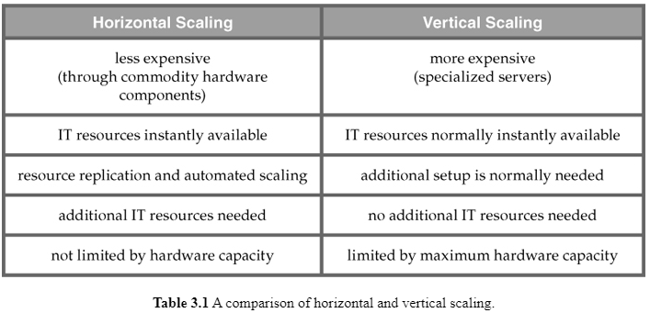
3.2. Basic Concepts and Terminology –Scaling
The pros and cons of each scaling

Slide 21
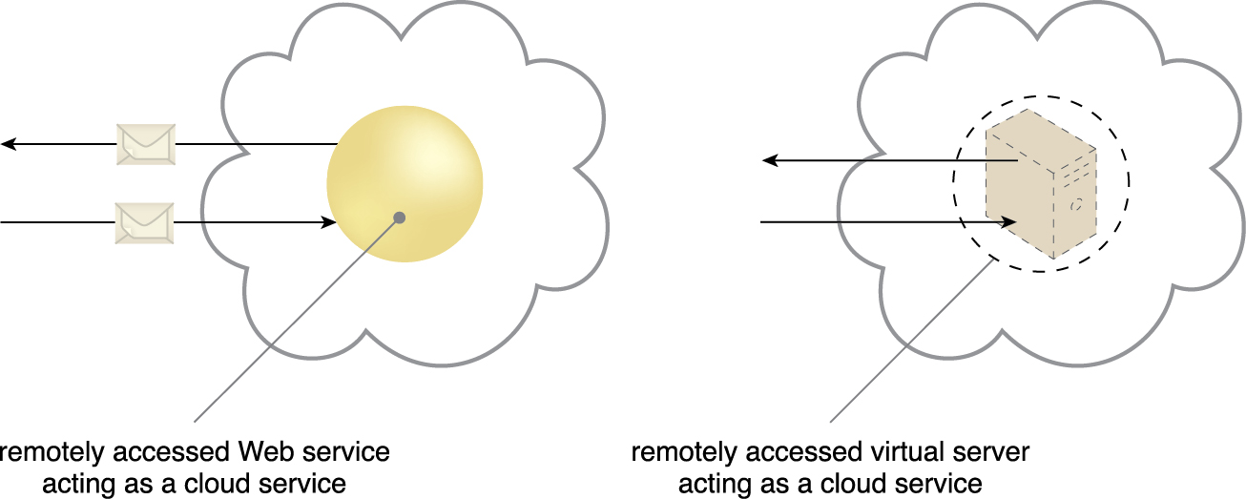
3.2. Basic Concepts and Terminology – Cloud Service
A cloud service is any IT resource that is made remotely accessible via a cloud
Although a cloud is a remotely accessible environment, not all IT resources residing within a cloud can be made available for remote access.
Figure 3.6 A cloud service with a published technical interface is being accessed by a consumer outside of the cloud (left). A cloud service that exists as a virtual server is also being accessed from outside of the cloud’s boundary (right). The cloud service on the left is likely being invoked by a consumer program that was designed to access the cloud service’s published technical interface. The cloud service on the right may be accessed by a human user that has remotely logged on to the virtual server.
Notes:
Figure:

Slide 22
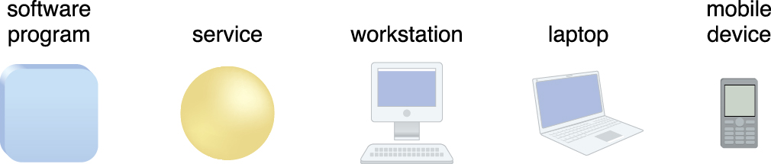
3.2. Cloud Service Consumer
The cloud service consumer is a temporary runtime role assumed by a software program when it accesses a cloud service
Common types of cloud service consumers can include software programs and services capable of remotely accessing cloud services with published service contracts, as well as workstations, laptops and mobile devices running software capable of remotely accessing other IT resources positioned as cloud services.
Figure 3.7 Examples of cloud service consumers. Depending on the nature of a given diagram, an artifact labeled as a cloud service consumer may be a software program or a hardware device (in which case it is implied that it is running a software program capable of acting as a cloud service consumer).
Notes:
Figure:

Slide 23
3.3. Goals and benefits-Reduced Investment
Public cloud providers base their business model on the mass-acquisition of IT resources that are then made available to cloud consumers via attractively priced leasing packages.
Organizations can gain access to powerful infrastructure without having to purchase it themselves
The most common economic rationale for investing in cloud-based IT resources is in the reduction or outright elimination of up-front IT investments
Hardware and software purchases and ownership costs.
Orgs can start small and increase accordingly
A cloud’s Measured Usage characteristic represents a feature-set that allows measured operational expenditures (directly related to business performance) to replace anticipated capital expenditures.
Also referred to as proportional costs.

Slide 24
3.3. Goals and benefits-Reduced Investment
Also by reducing up-front cost, a company can use that capital for other parts of the business
Cloud providers are able to offer these services at a low price because they acquire and place data centers where resources are inexpensive
Real estate
IT Professional
Bandwidth
Pooled IT resources (OS, Apps, Middleware, etc) are made available to guarantee maximum utilization
Better margins for Provider when consumer utilization is higher

Slide 25
3.3. Goals and benefits-Reduced Investment
Common measurable benefits to cloud consumers include:
On-demand access to pay-as-you-go computing resources on a short-term basis (such as processors by the hour), and the ability to release these computing resources when they are no longer needed.
The perception of having unlimited computing resources that are available on demand, thereby reducing the need to prepare for provisioning.
The ability to add or remove IT resources at a fine-grained level, such as modifying available storage disk space by single gigabyte increments.
Abstraction of the infrastructure so applications are not locked into devices or locations and can be easily moved if needed.

Slide 26
3.3. Goals and benefits-Reduced Investment
When speed and efficiency is important, cloud elasticity in compelling
Using 1 server for 100 hours cost the same as using 100 servers for 1 hour without additional provisioning
The apparent financial benefit of cloud adoption is not always as easy as leasing vs purchasing cost.
The financial benefits of dynamic scaling and the risk transference of both over-provisioning (under-utilization) and under-provisioning (over-utilization) must also be accounted for.

Slide 27
3.3. Goals and benefits-Increased Scalability
By providing pools of IT resources, clouds can instantly and dynamically allocate IT resources to cloud consumers
on-demand or via the cloud consumer’s direct configuration.
It empowers cloud consumers to scale their cloud-based IT resources to accommodate processing fluctuations and peaks automatically or manually.
Similarly, cloud-based IT resources can be released (automatically or manually) as processing demands decrease.
From a business prospective, cost saving when less resources are needed as well as avoid the loss of business when utilization is high but can’t meet demand.

Slide 28
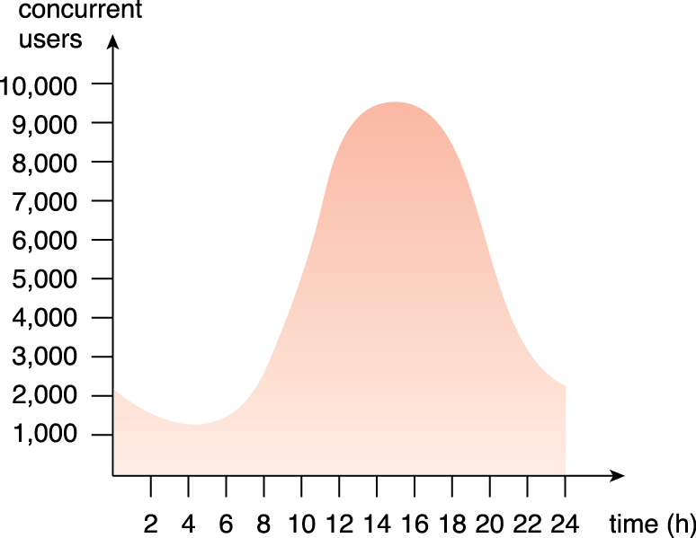
3.3. Goals and benefits-Increased Scalability
Figure 3.8 An example of an organization’s changing demand for an IT resource over the course of a day.
Notes:
Figure:

Slide 29
3.3. Goals and benefits-Increased Availability & Reliability
The availability and reliability of IT resources are directly associated with tangible business benefits.
Outages limit the time an IT resource can be “open for business” for its customers, thereby limiting its usage and revenue generating potential.
Runtime failures that are not immediately corrected can have a more significant impact during high-volume usage periods.
IT resource unable to respond to customer requests
unexpected failure can decrease overall customer confidence.

Slide 30
3.3. Goals and benefits-Increased Availability & Reliability
A main staple of the typical cloud environment is
its intrinsic ability to provide extensive support for increasing the availability of a cloud-based IT resource
to minimize or even eliminate outages
for increasing its reliability so as to minimize the impact of runtime failure conditions.
The longer an IT resource is available, the more it can be accessed
An IT resource with increased reliability is able to better avoid and recover from exception conditions

Slide 31
3.4. Risks & Challenges – Increased Security Vulnerabilities
The moving of business data to the cloud means that the responsibility over data security becomes shared with the cloud provider.
The remote usage of IT resources requires an expansion of trust boundaries by the cloud consumer to include the external cloud.
Can be difficult to establish a security architecture that spans such a trust boundary without introducing vulnerabilities
Mitigated if cloud consumers and cloud providers happen to support the same or compatible security frameworks (unlikely with public clouds)

Slide 32
3.4. Risks & Challenges – Increased Security Vulnerabilities
Another consequence of overlapping trust boundaries relates to the cloud provider’s privileged access to cloud consumer data.
Data security is now limited to the security controls and policies applied by both the cloud consumer and cloud provider.
Furthermore, there can be overlapping trust boundaries from different cloud consumers due to the fact that cloud-based IT resources are commonly shared.
Can be challenging for provider to offer security mechanism to accommodate security requirement for cloud service consumers

Slide 33
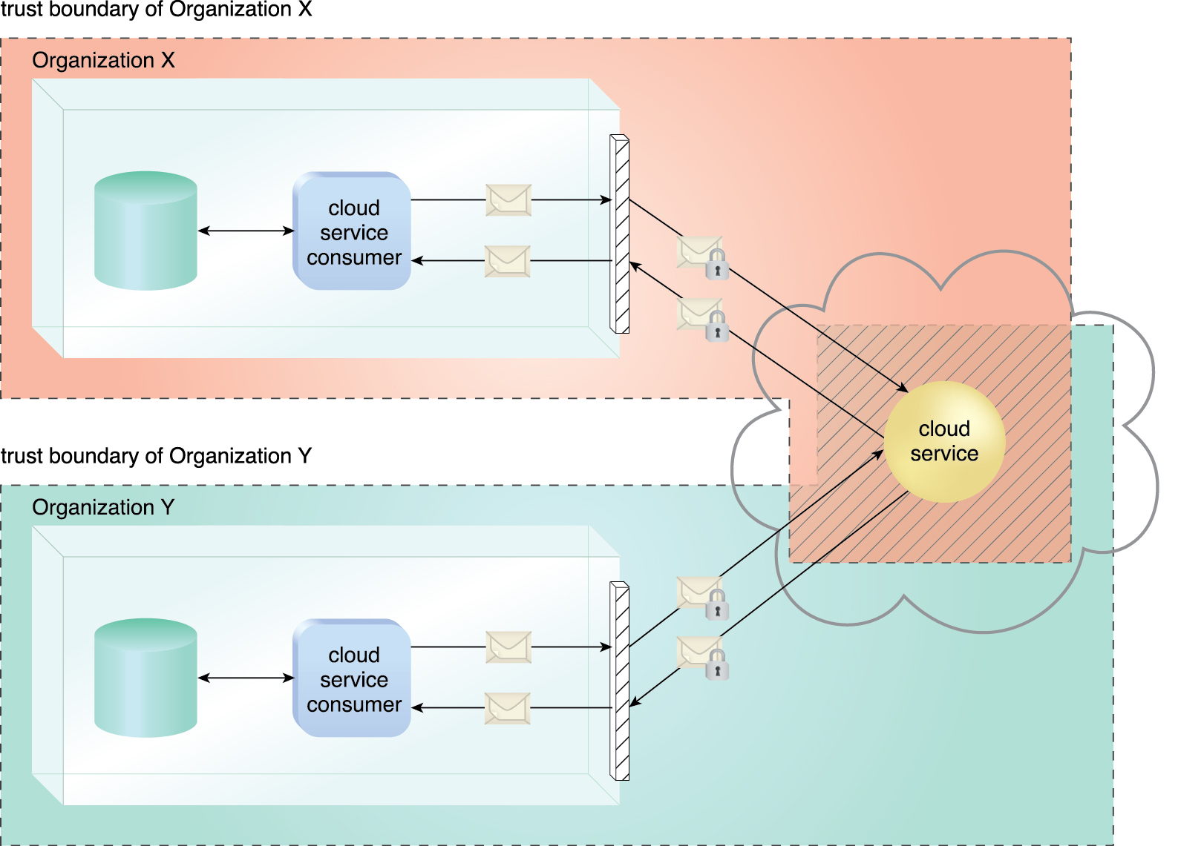
3.4. Risks & Challenges – Increased Security Vulnerabilities
The overlapping of trust boundaries and the increased exposure of data can provide malicious cloud consumers (human and automated) with greater opportunities to attack IT resources and steal or damage business data
Figure 3.9 The shaded area with diagonal lines indicates the overlap of two organizations’
trust boundaries.
Notes:
Figure:

Slide 34
3.4. Risks & Challenges – Reduced Operational Governance Control
Cloud consumers are usually allotted a level of governance control that is lower than that over on-premise IT resources.
Can introduce risks associated with how the cloud provider operates its cloud
As well as the external connections that are required for communication between the cloud and the cloud consumer.

Slide 35
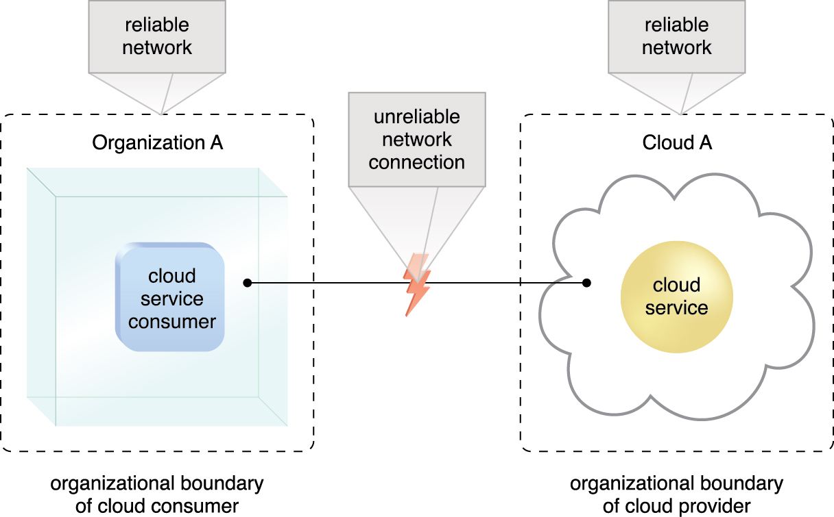
3.4. Risks & Challenges – Examples
An unreliable cloud provider may not maintain the guarantees it makes in the SLAs that were published for its cloud services.
Jeopardizes the quality of the cloud consumer solutions that rely on these cloud services.
Longer geographic distances between the cloud consumer and cloud provider can require additional network hops that introduce fluctuating latency and potential bandwidth constraints.
Figure 3.10 An unreliable network connection compromises the quality of communication between cloud
consumer and cloud provider environments.
Notes:
Figure:

Slide 36
3.4. Risks & Challenges – Reduced Operational Governance Control
To mitigate governance risks and issue
Have legal contracts in place
SLAs
Technology inspections
Monitoring
A cloud consumer must keep track of the actual service level being offered and the other warranties that are made by the cloud provider.

Slide 37
3.4. Risks & Challenges – Limited Portability Between Cloud Providers
Due to a lack of established industry standards within the cloud computing industry, public clouds are commonly proprietary to various extents.
For cloud consumers that have custom-built solutions with dependencies on these proprietary environments, it can be challenging to move from one cloud provider to another.
Portability is a measure used to determine the impact of moving cloud consumer IT resources and data between clouds

Slide 38
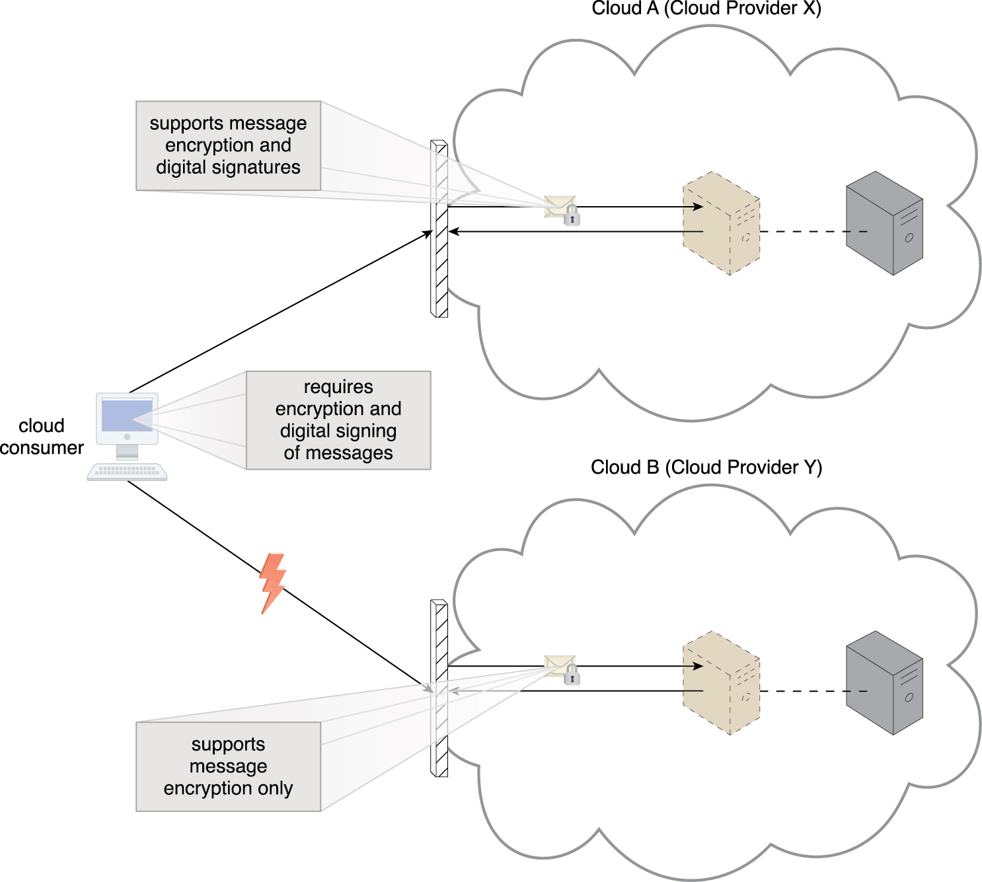
3.4. Risks & Challenges – Limited Portability Between Cloud Providers
Figure 3.11 A cloud consumer’s application has a decreased level of portability when assessing a potential migration from Cloud A to Cloud B, because the cloud provider of Cloud B does not support the same security technologies as Cloud A.
Notes:
Figure:

Slide 39
3.4. Risks & Challenges – Multi-Regional Compliance and Legal Issues
Third-party cloud providers will establish data centers in affordable or convenient locations.
Cloud consumer may not be aware of where their data is located
This can pose legal concerns or government regulations violations
Data must remain in country
Some countries require your data be disclosed
Most regulatory frameworks recognize that cloud consumer organizations are ultimately responsible for the security, integrity, and storage of their own data, even when it is held by an external cloud provider.

